Slide 1
SDG 3 | Good Health & Well-being
18 Sep, 2026
NutriPlan
Benjamin & Min
AI For Good
Week 2
Hackathon
Presentation

Slide 2
NutriPlan
Problem
⅓ EU residents
consumed
no fruit or vegi
29% adults
meet vegetable guideline
50.6%
EU population
Overweight
(Eurostat, 2022)
(RIVM, 2023)
(Eurostat, 2026)

Slide 3

NutriPlan
Problem
Budget Constraint
Uncertainty
about what to cook
Limited Time
Struggling to plan healthy meals

Slide 4
NutriPlan
Target Groups
Busy Adults &
Households
Students
living indepently
Families
with multiple ppl

Slide 5
NutriPlan
Solution: NutriPlan
User Input
A Personalised Meal-Planning AI assistant.
AI Planing
To reduce planning effort &
encourage healthier everyday choices.
Meal Plan + Shopping List

Slide 6
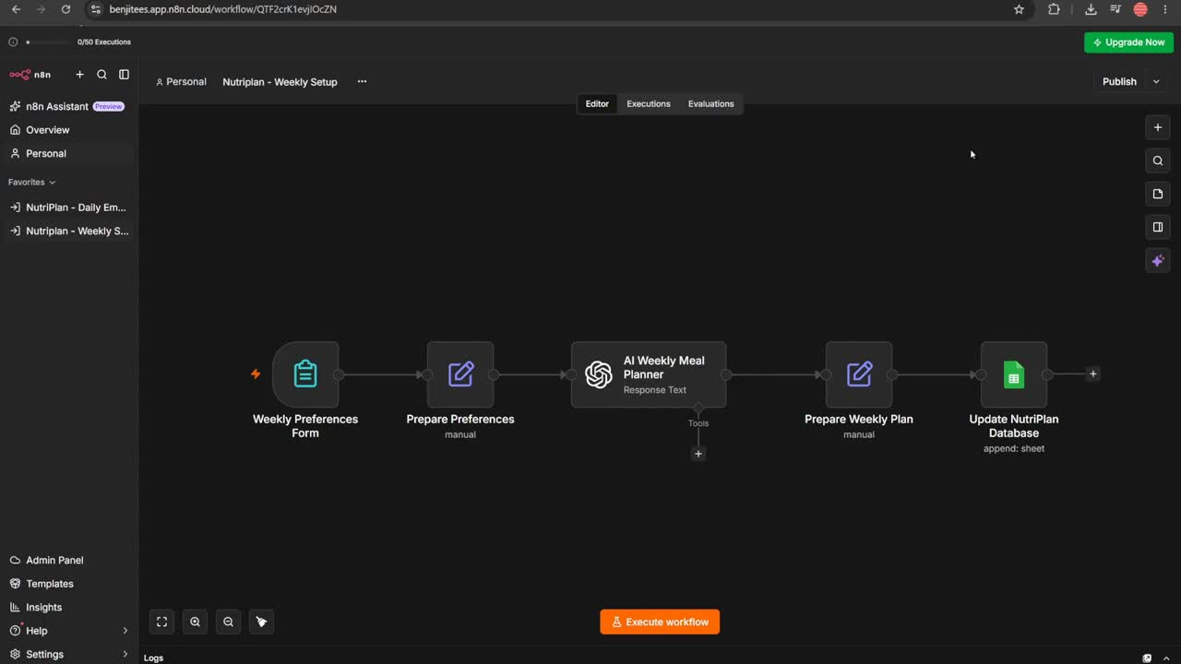
Demo
NutriPlan

Slide 7
SDG 3 | Good Health & Well-being
18 Sep, 2026
Question?
NutriPlan AI
AI For Good
Week 2
Hackathon
Presentation

